Slide 1
Introduction to Statistics for Ecology and Evolutionary Biology Binomial Regression Week 12 15 April 2019

Slide 2
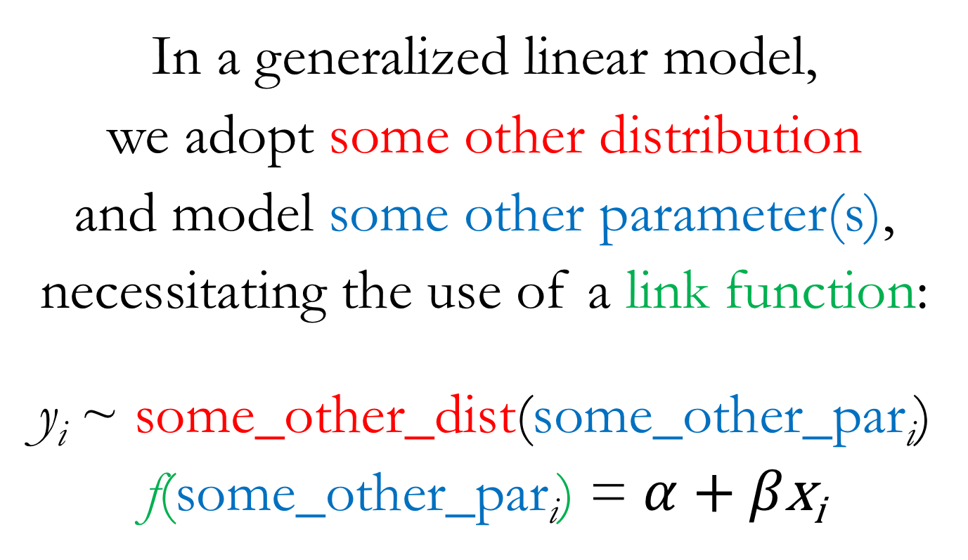
From Linear Models to Generalized Linear Models (GLMs)
In a generalized linear model,
we adopt some other distribution
and model some other parameter(s),
necessitating the use of a link function:
y_{i} ~ some_other_dist(some_other_par$\text{i}$)
f(some_other_par$\text{i}$) = $α$ + $β\text{x}\text{i}$
Notes:
Modeling of different parameters will usually necessitate the use of a link function
This is because the new parameters we’ll be interested in modeling are typically not unbounded in both directions
Conveniently, the target of most of our modeling effort so far, the mean parameter in a Gaussian distribution, has been unbounded in both directions, making it easier for us up until this point

Slide 3
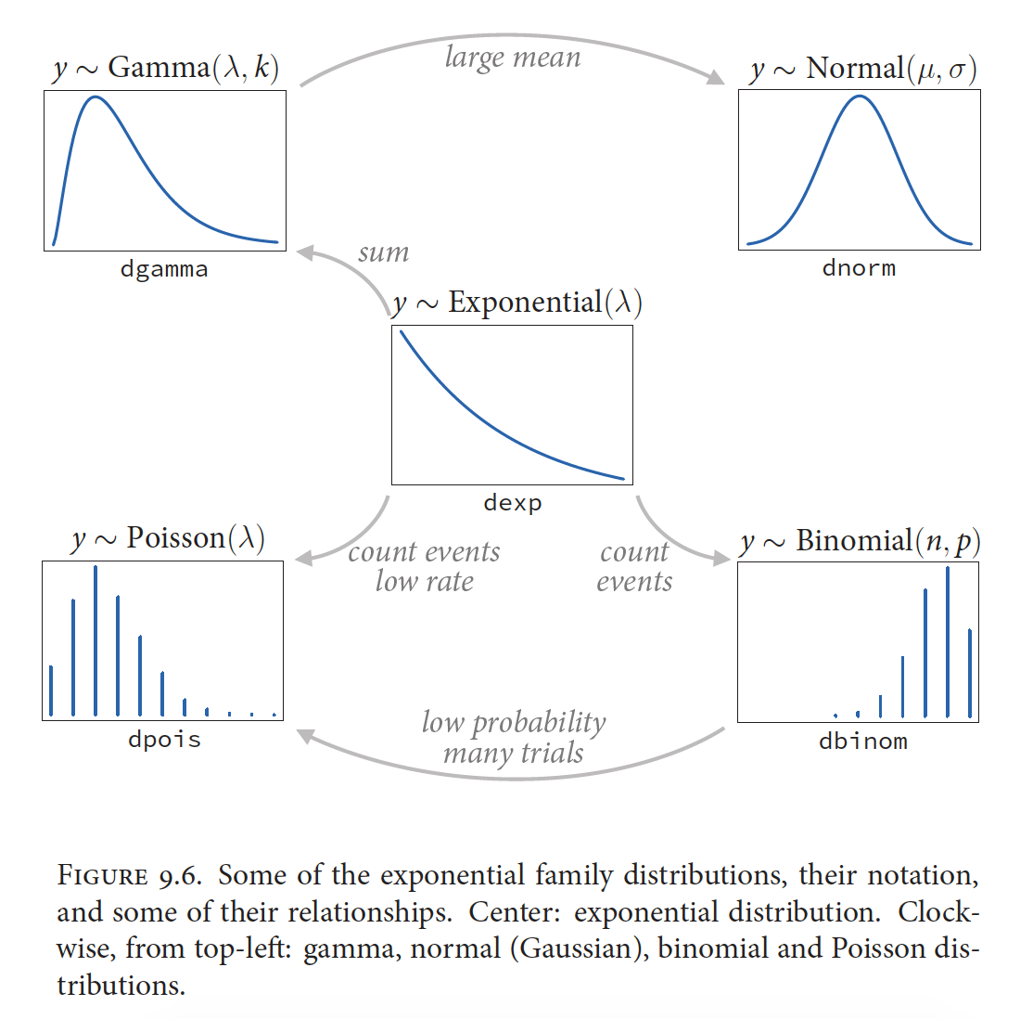
McElreath 2016, Statistical Rethinking

Slide 4
Binomial Distribution
A discrete probability distribution with two parameters:
n = number of trials, p = probability of success
Outcome is the number of successes (x) in n trials with probability of success p
The probability mass function in R:
dbinom(x, size, prob)
Where x = the number of successes, size = n, prob = p
Which can be visualized like so:
plot(0:10, dbinom(0:10, size = 10, prob = 0.3))
The random generation function in R:
rbinom(n, size, prob)
Where n = the number of observations to generate, size = n, prob = p

Slide 5
Probability
p
Bounds: 0 to 1

Slide 6
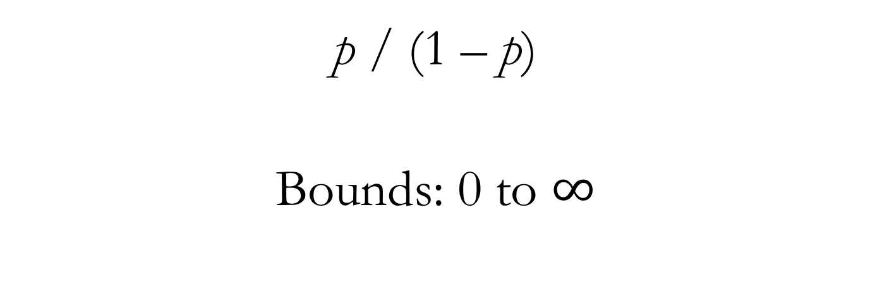
Odds
p / (1 – p)
Bounds: 0 to $∞$

Slide 7
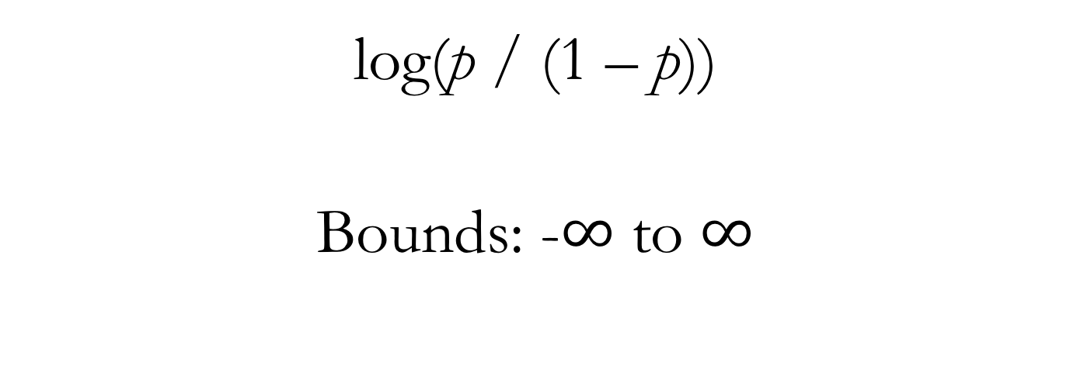
Log-odds (aka the Logit Function)
log(p / (1 – p))
Bounds: -$∞$ to $∞$

Slide 8
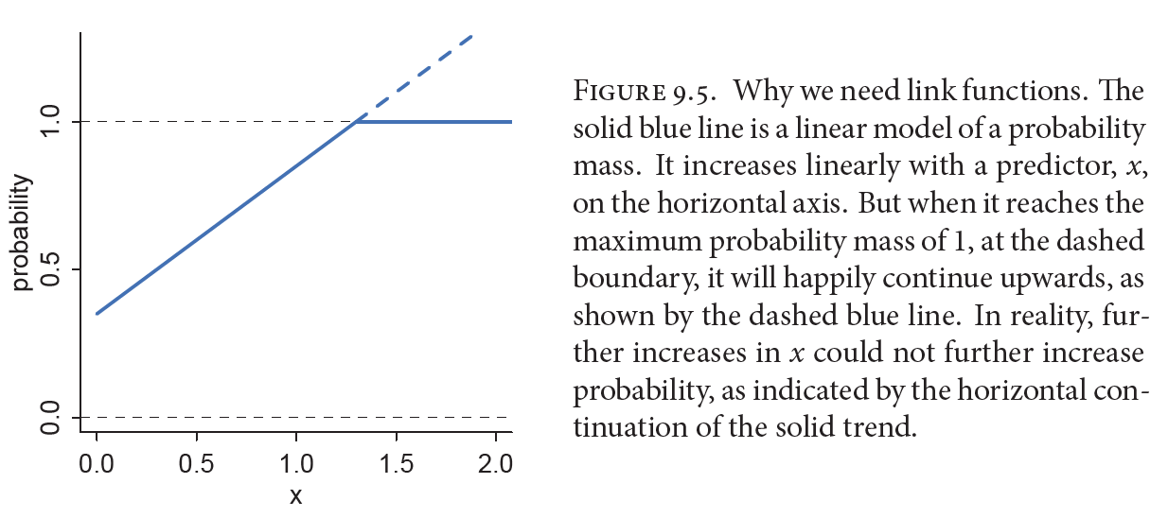
The Necessity of Link Functions
McElreath 2016, Statistical Rethinking
Notes:
“A link function’s job is to map the linear space of a model…onto the non-linear space of a parameter like...So f is chosen with that goal in mind.”

Slide 9
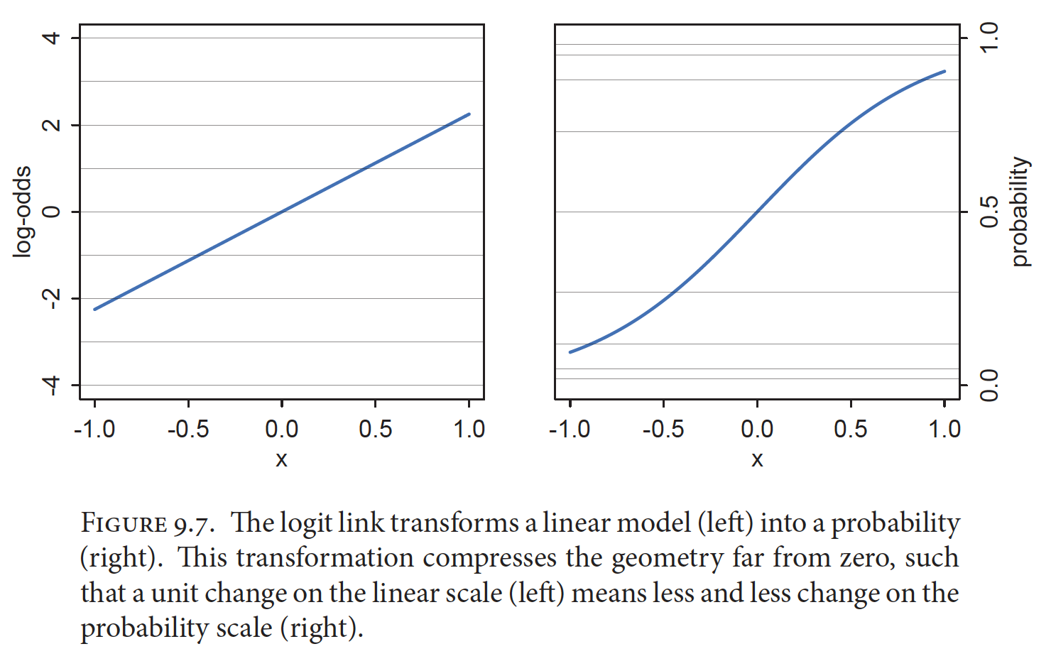
Logit Link for Binomial GLMs
McElreath 2016, Statistical Rethinking
Notes:
“The logit link maps a parameter that is defined as a probability mass, and therefore constrained to lie between zero and one, onto a linear model that can take on any real value.”
The inverse of the logit function is the logistic function (also sometimes called the inverse-logit)
Show lecture code relating to probabilities, odds, and log-odds

Slide 10

Binomial GLM
y_{i} ~ Binomial(n, p_{i})
logit(p_{i}) = $α$ + $β\text{x}\text{i}$

Slide 11
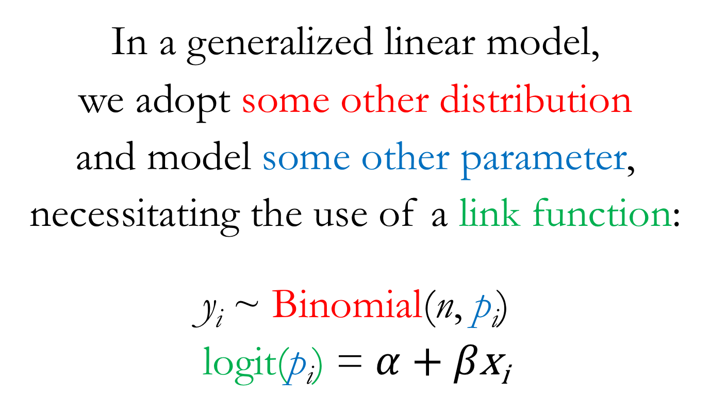
Binomial GLM
In a generalized linear model,
we adopt some other distribution
and model some other parameter,
necessitating the use of a link function:
y_{i} ~ Binomial(n, p_{i})
logit(p_{i}) = $α$ + $β\text{x}\text{i}$

Slide 12
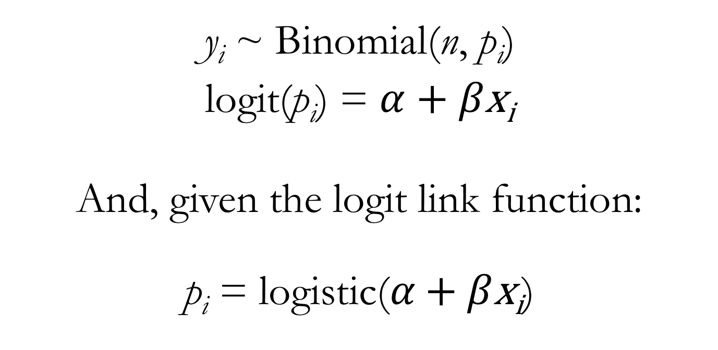
Binomial GLM
y_{i} ~ Binomial(n, p_{i})
logit(p_{i}) = $α$ + $β\text{x}\text{i}$
And, given the logit link function:
$\text{p}\text{i}\text{ =} \text{logi}\text{s}\text{t}\text{ic}\text{(}α\text{ + }β\text{x}\text{i}$)
Notes:
So you can think about this one of two ways:
The linear portion of our model is used to model the logit-transformed parameter value (which puts it on the unbounded scale)
OR: the raw parameter value is defined by applying the inverse link function (the logistic) to the linear portion of the model (forcing the linear portion of the model to take on values between 0 and 1)

Slide 13
Two Flavors of Binomial GLM
Logistic regression commonly refers to the situation when binomial data are organized into single-trial cases
So the number of trials (n) for every observation will simply be 1
And the number of successes (y) can only be 0 or 1
Aggregated binomial regression refers to the situation when binomial data are aggregated for all observations having the same covariate values
So the number of trials (n) for every “observation” may differ
And the number of successes (y) can range from 0 to n

Slide 14
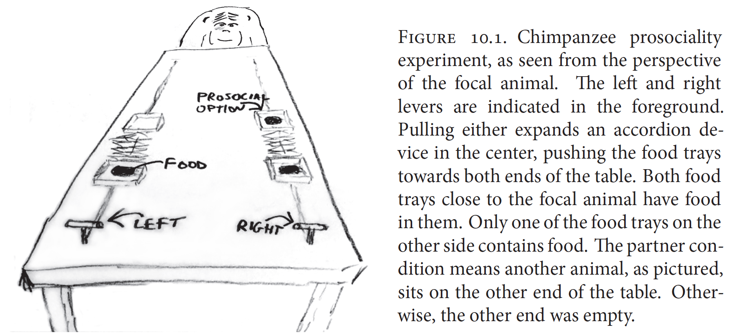
Prosocial Chimpanzees
McElreath 2016, Statistical Rethinking
Notes:
Two experimental variables of interest: the side of the table on which the prosocial option appeared and partner vs. control condition

Slide 15
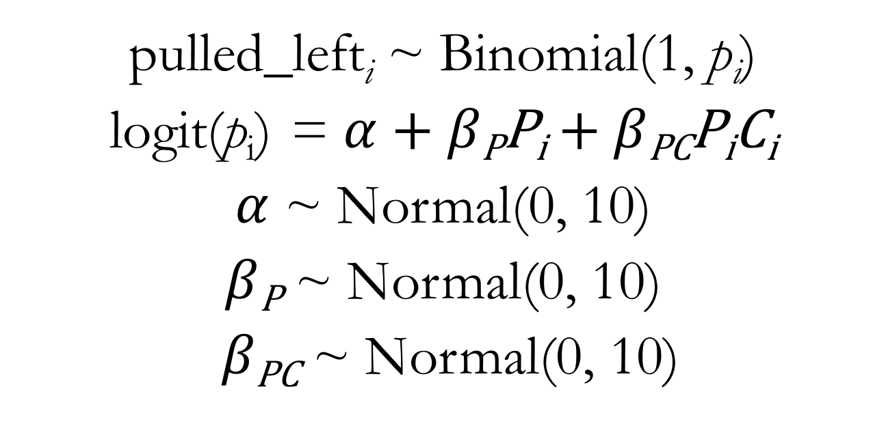
Binomial GLM for Chimpanzee Prosociality Predictors: Prosocial and Interaction between Prosocial and Condition
pulled_left_{i} ~ Binomial(1, $\text{p}\text{i}$)
logit(p_{i}) = $α$ + $β\text{P}\text{P}\text{i}$ + $β\text{PC}\text{P}\text{i}\text{C}\text{i}$
$α$ ~ Normal(0, 10)
$β\text{P}$ ~ Normal(0, 10)
$β\text{PC}$ ~ Normal(0, 10)
Notes:
Note that this model does not have a main effect of condition

Slide 16
Many Shades of Snow Geese
White Morph
Blue Morph
Notes:
https://www.allaboutbirds.org/guide/Snow_Goose/media-browser/59939451
https://www.allaboutbirds.org/guide/Snow_Goose/media-browser/78204831

